Slide 1
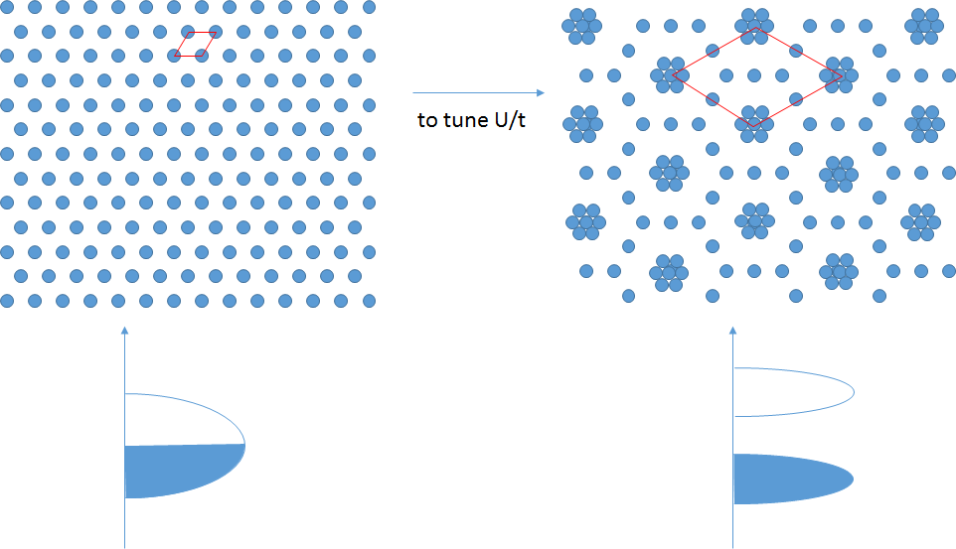
Figure 1. Schematic illustration of inducing an large Mott gap in an artificial 2D system.
a
b
c
d

Slide 2
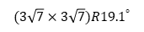
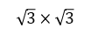
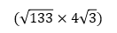
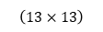
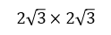
Figure S1. MBE growth of Sn submonolayers on Si(111) substrate.
a
b
$$\left(13×13\right)$$
c
$$(\sqrt{133}×4\sqrt{3})$$
As-deposited surface
Anneal at ~230℃
Anneal at ~350℃
d
$$(3\sqrt{7}×3\sqrt{7})R{19.1}^{°}$$
e
$$2\sqrt{3}×2\sqrt{3}$$
f
$$\sqrt{3}×\sqrt{3}$$
Anneal at ~400℃
Anneal at ~550℃
Anneal at ~700℃

Slide 3
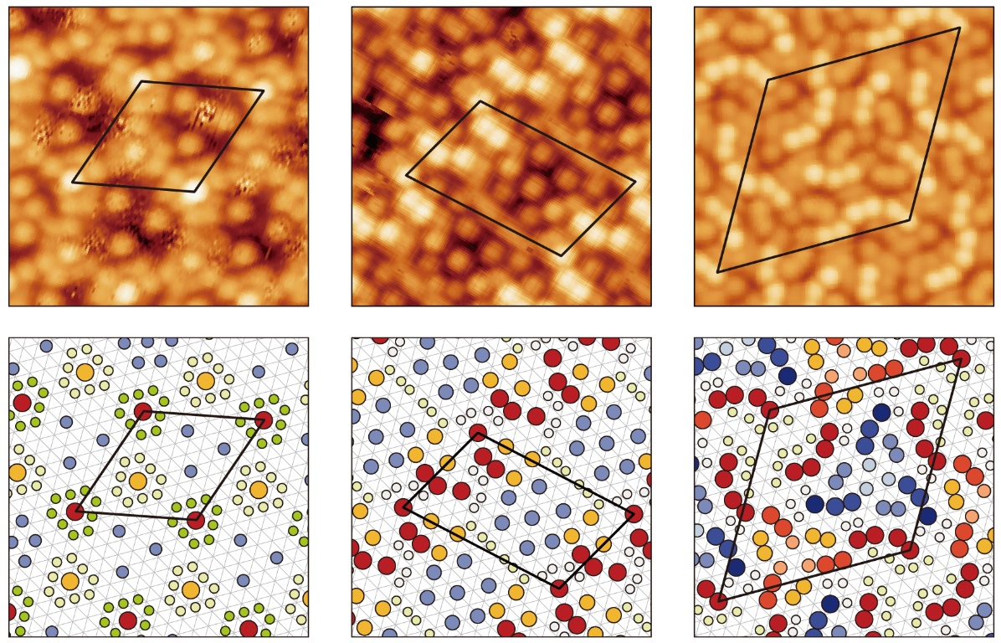
Figure 2. STM characterization of three new structures of Sn/Si(111) submonolayer.
a
Phase 1
b
Phase 2
c
Phase 3
d
e
f
g
h
i

Slide 4
Figure S2. Atomic resolutions taken on phase 1 at different energies.
-2 V
+3.5 V
+4 V
+5 V
+6 V
+7 V

Slide 5
Figure S3. Atomic resolutions taken on phase 2 at different energies.
-2 V
-4 V
+3 V
+4 V
+5 V
+6 V
+7 V

Slide 6
Figure S4. Atomic resolutions taken on phase 3 at different energies.
-2 V
-3 V
+3.2 V
+3.5 V
+4 V
+4.5 V
+5 V

Slide 7
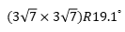
Figure 3. The observation of large energy gaps on the three different surfaces.
a
b
$$(3\sqrt{7}×3\sqrt{7})R{19.1}^{°}$$
c

Slide 8
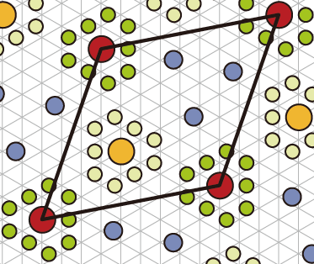
Figure S5. dI/dV spectra taken on $(3\sqrt{7}×3\sqrt{7})R{19.1}^{°}$ surface.
Index=0
Index=1
Index=2
Index=3
22
21
18
17
16
15
20
19
10
14
Index=4
Index=5
Index=6
Index=7
9
8
7
6
11
12
13
1
0
5
2
4
3
Index=8
Index=9
Index=10
Index=11
Index=12
Index=13
Index=14
Index=15
Index=16
Index=17
Index=18
Index=19
Index=20
Index=21
Index=22

Slide 9
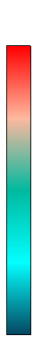
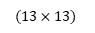
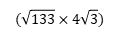
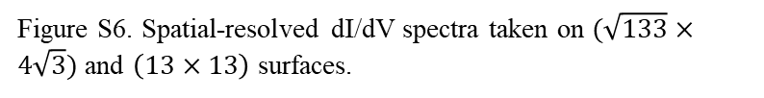
Figure S6. Spatial-resolved dI/dV spectra taken on $(\sqrt{133}×4\sqrt{3})$ and $\left(13×13\right)$ surfaces.
$$(\sqrt{133}×4\sqrt{3})$$
High
Low
$$(13×13)$$

Slide 10
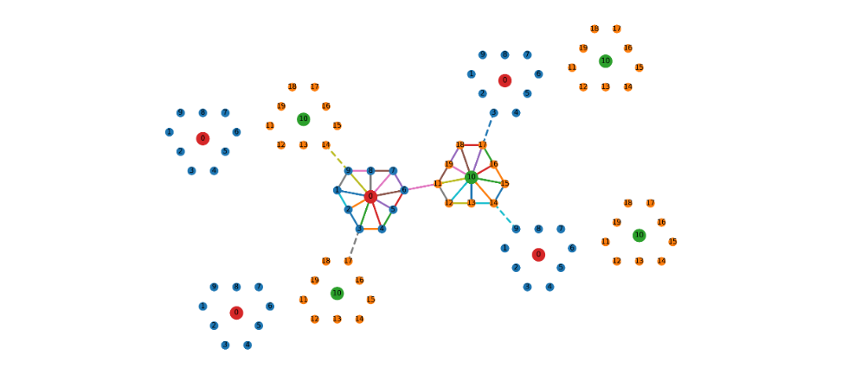
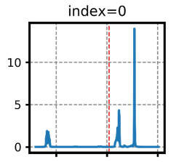
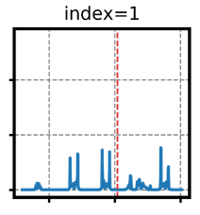
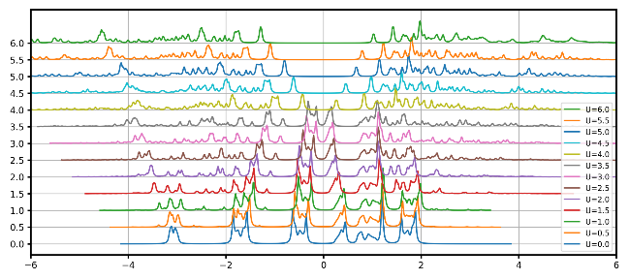
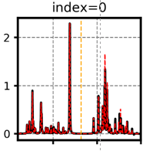
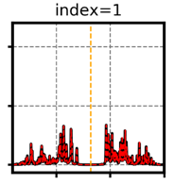
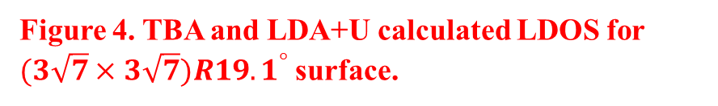
Figure 4. TBA and LDA+U calculated LDOS for $(3\sqrt{7}×3\sqrt{7})R{19.1}^{°}$surface.
a
c
U=0
b
d
U=6

Slide 11
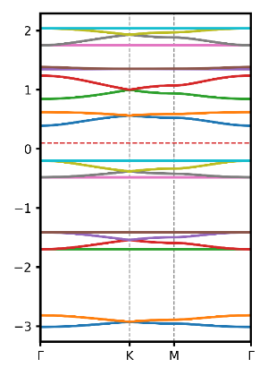
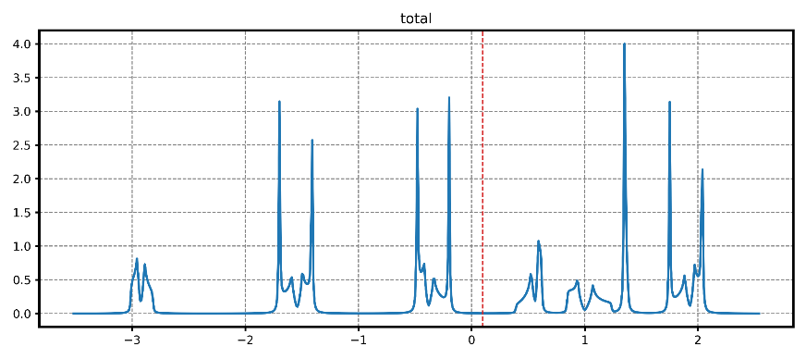
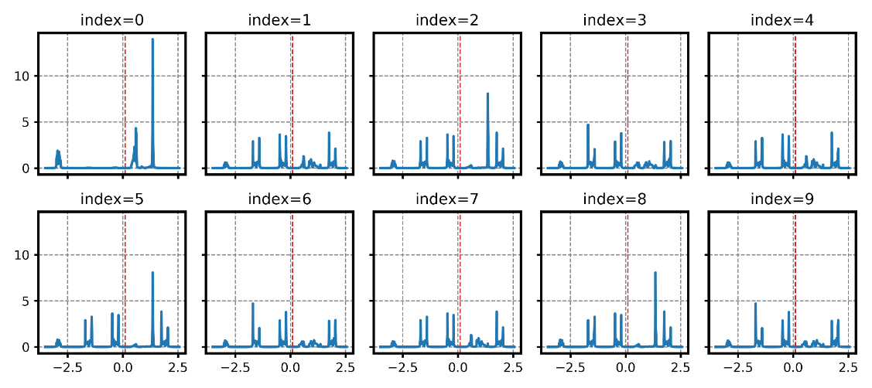
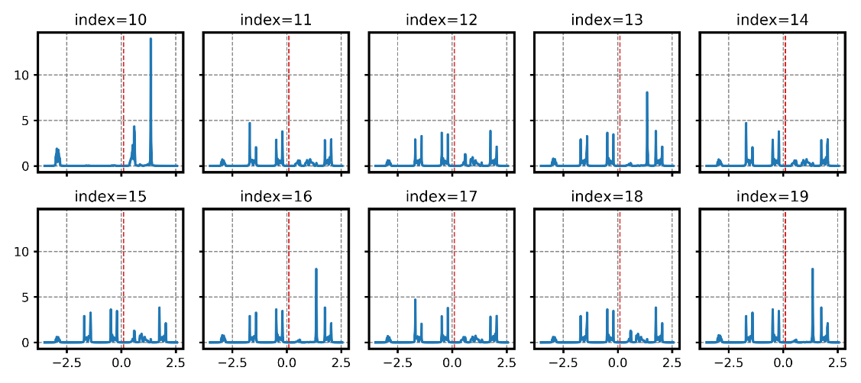
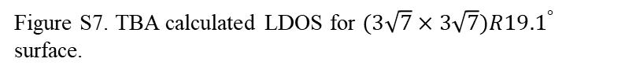
Figure S7. TBA calculated LDOS for $(3\sqrt{7}×3\sqrt{7})R{19.1}^{°}$ surface.

Slide 12
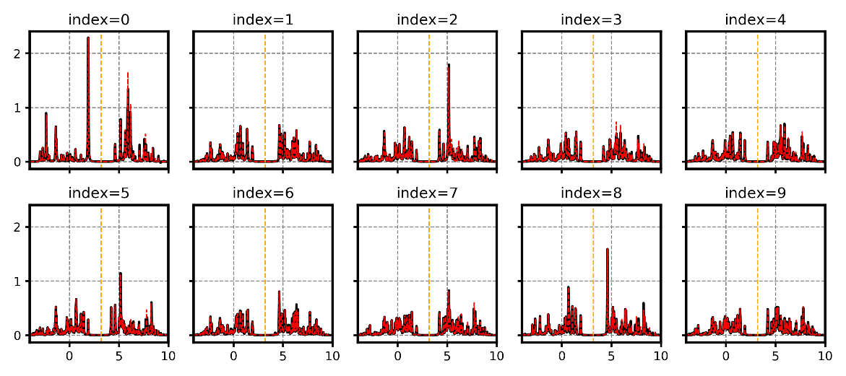
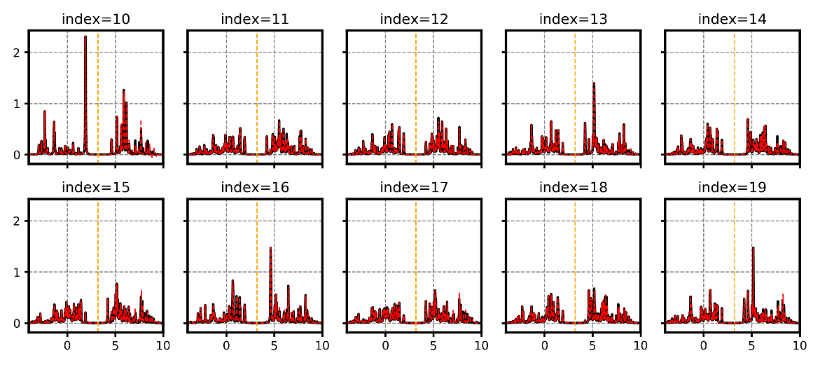
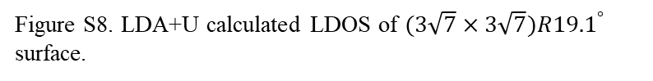
Figure S8. LDA+U calculated LDOS of $(3\sqrt{7}×3\sqrt{7})R{19.1}^{°}$ surface.

Slide 13
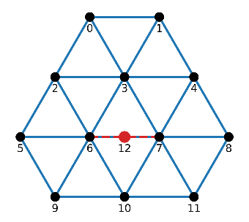
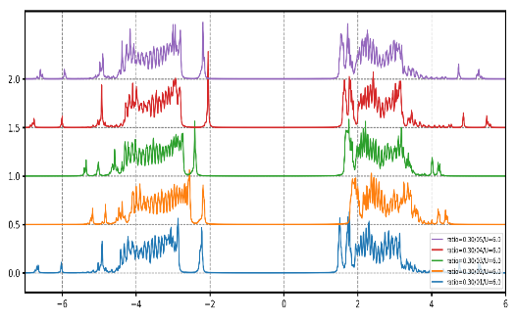
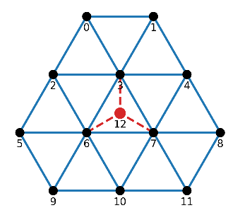
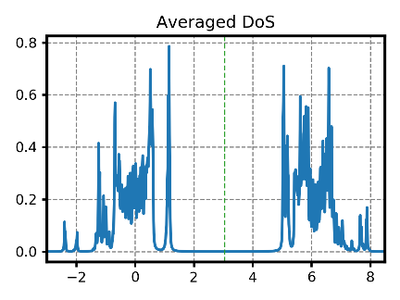
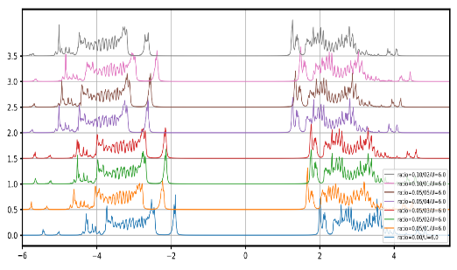
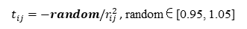
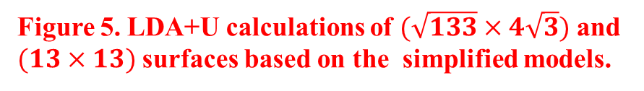
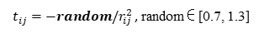
Figure 5. LDA+U calculations of $(\sqrt{133}×4\sqrt{3})$ and $(13×13)$ surfaces based on the simplified models.
a
b
c
$t_{ij}=−random/r_{ij }^{2}$, random∈[0.7, 1.3]
U=6
d
e
f
$t_{ij}=−random/r_{ij }^{2}$, random∈[0.95, 1.05]
U=6

Slide 14
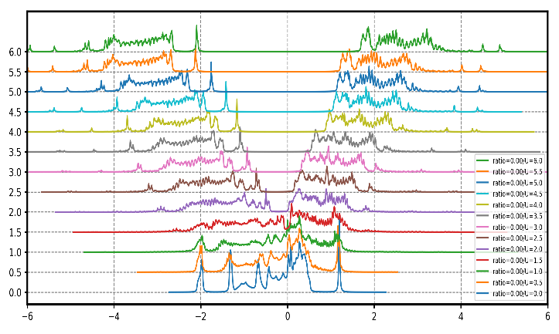
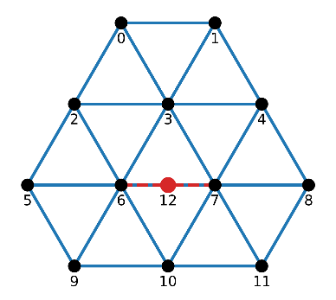
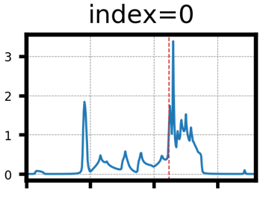
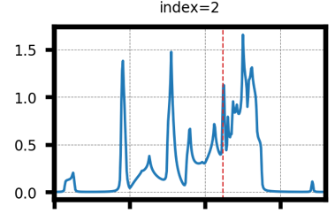
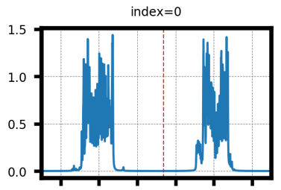
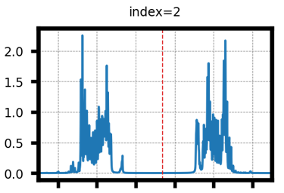
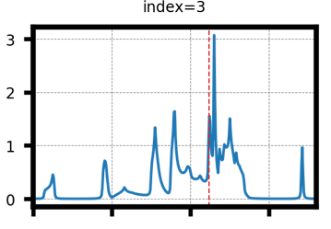
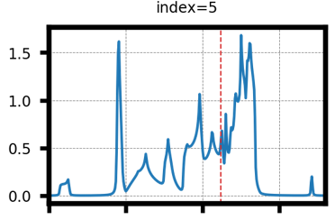
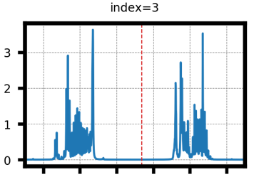
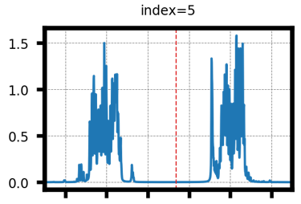
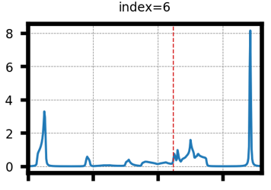
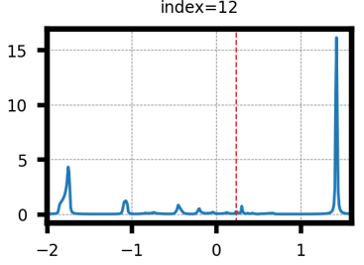
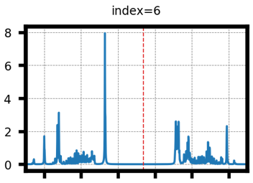
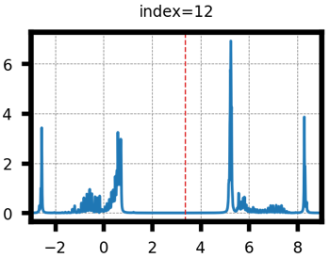

Figure S9. Calculated LDOS with / without U for $(\sqrt{133}×4\sqrt{3})$ surface.
U=0
U=6

Slide 15



Figure S10. Calculated Hubbard-U dependent average LDOS with random hopping t for $(\sqrt{133}×4\sqrt{3})$ surface.
$t_{ij}=−random/r_{ij }^{2}$, random∈[0.7, 1.3]

Slide 16











Figure S11. Calculated LDOS with/without Hubbard-U for $(13×13)$ surface .
U=0
U=6

Slide 17



Figure S12. Calculated Hubbard-U dependent average LDOS with random hopping t for $(13×13)$ surface.
$t_{ij}=−random/r_{ij }^{2}$, random∈[0.95, 1.05]

